Slide 1
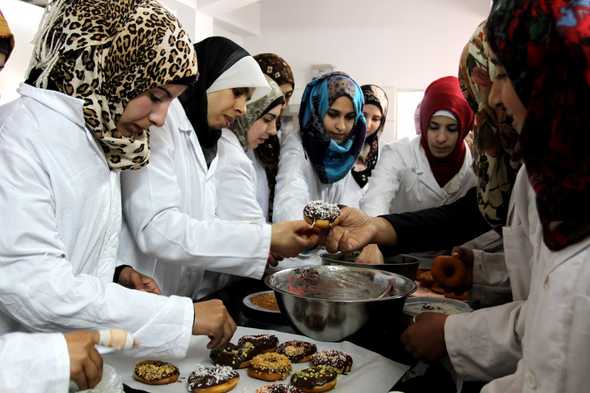
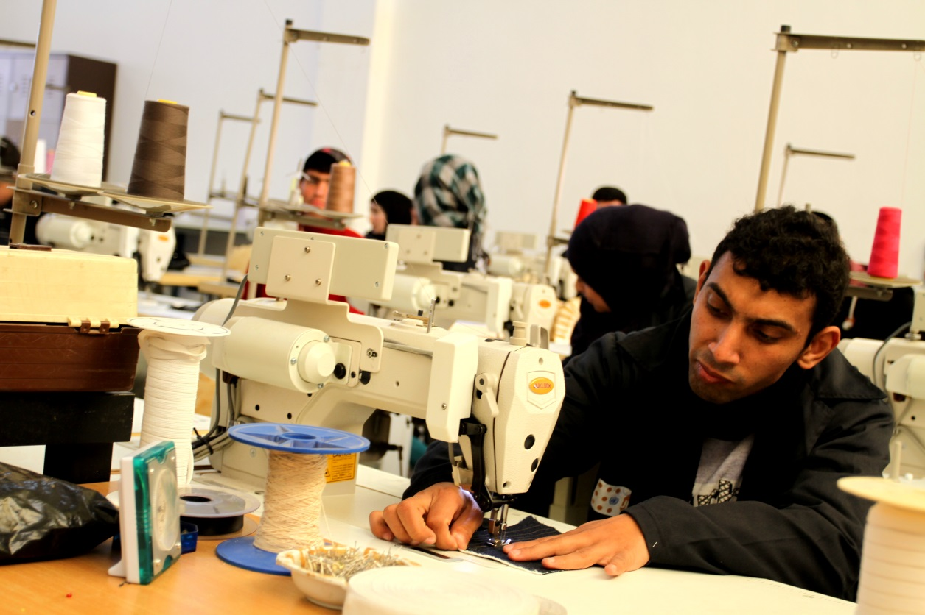
Promotion of TVET and LM Programme
Communication Strategy + Measures

Slide 2
Promotion of TVET and LM Programme
Core Messages
TVET is attractive and a full equivalent alternative to academic education and not a “second choice”!
It offers not only educational and career progress but also personal development
It provides employment opportunities with regard to good income perspectives
It is a stepping stone into the field of work

Slide 3
Objectives of our communication measures
Establish an umbrella brand of TVET/LM and strengthen the public image of TVET/LM
Raise awareness among partners, stakeholders, public towards TVET/LM services and instruments
Encourage cooperation between TVET/LM providers and governmental institutions / private sector
Services of the LM services are being used
PR counterparts in the Ministries and in partner institutions is trained and capable to promote their services
Notes:
Objectives of a Communication Strategy for the TVET/LM Programme
Public awareness in regard to the importance and value of TVET is raised. The public perceives TVET in a positive way.
Public awareness for employment instruments is raised. Employers and youth make increasingly use of offered labour market instruments with special emphasis on integration of gender, encouraging female enrolment.
The cooperation between TVET & LM is improved. The linkages between TVET and the private sector with regard to the quality and labour market relevance of TVET are strengthened, as an outcome creating additional opportunities for internships, apprenticeships and employment.
Relevant target groups are informed about the establishment of frameworks and instruments of both strategies.
“TVET and LM” are established as an umbrella brand. The contributions of SDC and EU are better visible.

Slide 4
Target Groups
Students/Parents
Private Sector
Media
Traditional Media
Pilots
Core Processes
TVET Institutions (Upgrading)
LM (OSS, LMIS, EA)
TVET / LM Programme
TVET Providers
Governmental Institutions
Online Media
Live Media
Marketing
CoC
NQF, NOC, Curriculum Development, HRD
Notes:
To whom do we want to deliver our message? Who do we want to target? Who do we aim at?
Clients and commissioning parties: EU, Swiss Development Cooperation
Governmental level: MoL, MoE, MoHEH
Private Sector: Chambers of Commerce, Business Associations, Entrepreneurs
TVET Institutions: Colleges, VTC’s, Schools, CoC’s
Students/ Parents, and Multipliers
Interested public, GIZ Personnel
Media

Slide 5
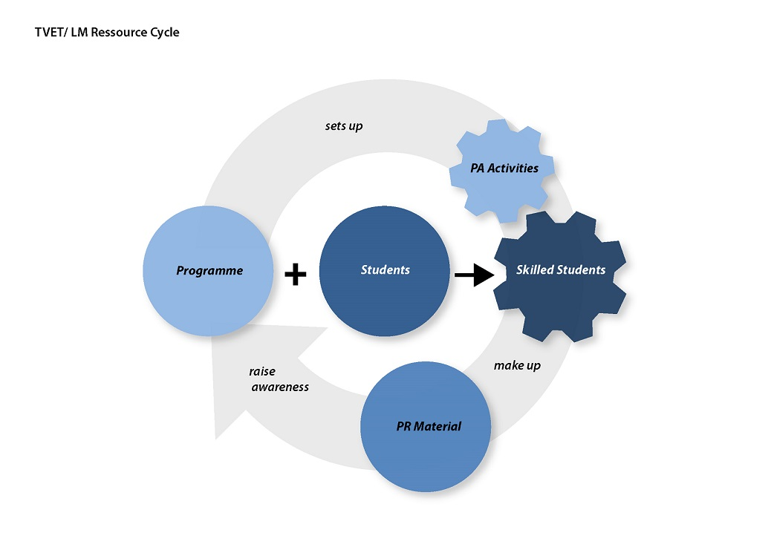
Notes:
2014
LAB
Aesthetic/ethics of work
Resource cycle → enrich each other / generate
Description of job profiles
Exemplary loop to illustrate TVET education process/job profiles
Ambassadors/multipliers in each TVET institution (students deliver their message)
Commitment and ownership are created among partners and students
Measurements:
PR Material (Calendar 2015, brochures, image films, photos) in workshop under guidance of local consultant with students
Open Days before summer holidays (films, photos), education tours, panel discussions, live workshops, lectures → organized by students
Paragraph in each Newsletter designed and content by students of one TVET institution
Monthly radio show in local radio station organized by students who invite TVET guest speakers
Survey about TVET education, benefits, chances (→ collection of positive quotes about TVET)
Events: Labour Day, National Employment Week, Career Days, GIZ Events
“TVET style” (workshops, events, schools)
PR/PA Campaigns: Network of institutions in each governorate (Ramallah, Bethl., Hebron, Nablus) → create synergies

Slide 6
Communication measures 2014 (April – December)
Pilot: Open Day TVET education Hebron & Bethlehem in cooperation with BTC
Media Training for partners in cooperation with Deutsche Welle
TVET/LM Newsletter
TVET/LM image films on single issues
TVET visibility
Media coverage
Up scaling TVET website
Fact sheet folder
Notes:
2014
LAB
Aesthetic/ethics of work
Resource cycle → enrich each other / generate
Description of job profiles
Exemplary loop to illustrate TVET education process/job profiles
Ambassadors/multipliers in each TVET institution (students deliver their message)
Commitment and ownership are created among partners and students
Measurements:
PR Material (Calendar 2015, brochures, image films, photos) in workshop under guidance of local consultant with students
Open Days before summer holidays (films, photos), education tours, panel discussions, live workshops, lectures → organized by students
Paragraph in each Newsletter designed and content by students of one TVET institution
Monthly radio show in local radio station organized by students who invite TVET guest speakers
Survey about TVET education, benefits, chances (→ collection of positive quotes about TVET)
Events: Labour Day, National Employment Week, Career Days, GIZ Events
“TVET style” (workshops, events, schools)
PR/PA Campaigns: Network of institutions in each governorate (Ramallah, Bethl., Hebron, Nablus) → create synergies

Slide 7
Open Day TVET education Hebron & Bethlehem
In cooperation with:
Partner: MoL, MoEHE, Federation of Palestinian Chambers of Commerce, Hebron Chamber of Commerce
Participants: 12 TVET providers Hebron & Bethlehem
Target groups: school students 9th & 10th gr. Hebron and Bethlehem Governorates, parents, private sector, interested public
Knowledge fair, live workshops, exhibitions, Dabke & theatre plays
Notes:
2014
LAB
Aesthetic/ethics of work
Resource cycle → enrich each other / generate
Description of job profiles
Exemplary loop to illustrate TVET education process/job profiles
Ambassadors/multipliers in each TVET institution (students deliver their message)
Commitment and ownership are created among partners and students
Measurements:
PR Material (Calendar 2015, brochures, image films, photos) in workshop under guidance of local consultant with students
Open Days before summer holidays (films, photos), education tours, panel discussions, live workshops, lectures → organized by students
Paragraph in each Newsletter designed and content by students of one TVET institution
Monthly radio show in local radio station organized by students who invite TVET guest speakers
Survey about TVET education, benefits, chances (→ collection of positive quotes about TVET)
Events: Labour Day, National Employment Week, Career Days, GIZ Events
“TVET style” (workshops, events, schools)
PR/PA Campaigns: Network of institutions in each governorate (Ramallah, Bethl., Hebron, Nablus) → create synergies

Slide 8
Media Training for partners → media awareness through media literacy
In cooperation with:
Partner: Media Department Birzeit University
Participants: PR counterparts of MoL, MoEHE, FOPCCI, TVET provider
Social media, website administration, formulating press releases, interview training
Notes:
2014
LAB
Aesthetic/ethics of work
Resource cycle → enrich each other / generate
Description of job profiles
Exemplary loop to illustrate TVET education process/job profiles
Ambassadors/multipliers in each TVET institution (students deliver their message)
Commitment and ownership are created among partners and students
Measurements:
PR Material (Calendar 2015, brochures, image films, photos) in workshop under guidance of local consultant with students
Open Days before summer holidays (films, photos), education tours, panel discussions, live workshops, lectures → organized by students
Paragraph in each Newsletter designed and content by students of one TVET institution
Monthly radio show in local radio station organized by students who invite TVET guest speakers
Survey about TVET education, benefits, chances (→ collection of positive quotes about TVET)
Events: Labour Day, National Employment Week, Career Days, GIZ Events
“TVET style” (workshops, events, schools)
PR/PA Campaigns: Network of institutions in each governorate (Ramallah, Bethl., Hebron, Nablus) → create synergies

Slide 9
TVET/LM in the media
Fateh Gaza http://www.fateh-gaza.com/ar/?Action=Details&ID=30813 Wafa News Agency http://www.wafa.ps/arabic/index.php?action=detail&id=170612 Al Ayam Newspaper Online http://www.al-ayyam.com/article.aspx?did=235889&date=
Notes:
2014
LAB
Aesthetic/ethics of work
Resource cycle → enrich each other / generate
Description of job profiles
Exemplary loop to illustrate TVET education process/job profiles
Ambassadors/multipliers in each TVET institution (students deliver their message)
Commitment and ownership are created among partners and students
Measurements:
PR Material (Calendar 2015, brochures, image films, photos) in workshop under guidance of local consultant with students
Open Days before summer holidays (films, photos), education tours, panel discussions, live workshops, lectures → organized by students
Paragraph in each Newsletter designed and content by students of one TVET institution
Monthly radio show in local radio station organized by students who invite TVET guest speakers
Survey about TVET education, benefits, chances (→ collection of positive quotes about TVET)
Events: Labour Day, National Employment Week, Career Days, GIZ Events
“TVET style” (workshops, events, schools)
PR/PA Campaigns: Network of institutions in each governorate (Ramallah, Bethl., Hebron, Nablus) → create synergies

Slide 10
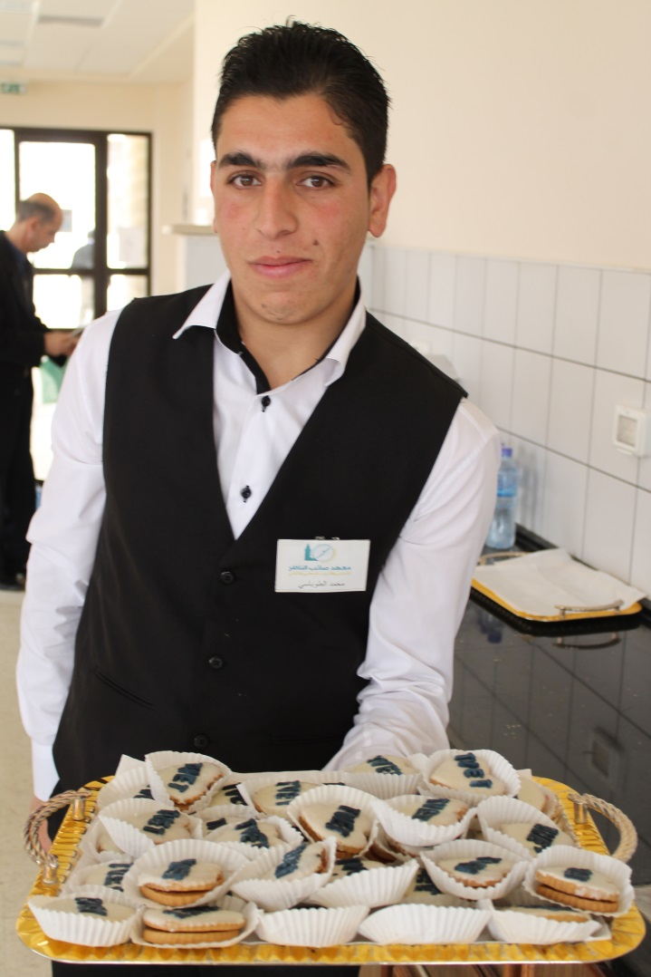
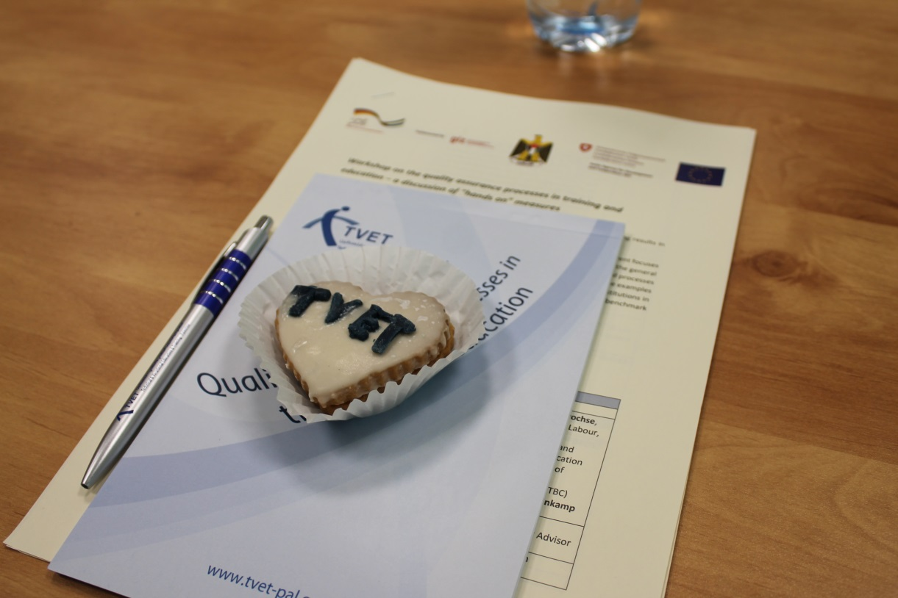
Visibility of TVET
Notes:
2014
LAB
Aesthetic/ethics of work
Resource cycle → enrich each other / generate
Description of job profiles
Exemplary loop to illustrate TVET education process/job profiles
Ambassadors/multipliers in each TVET institution (students deliver their message)
Commitment and ownership are created among partners and students
Measurements:
PR Material (Calendar 2015, brochures, image films, photos) in workshop under guidance of local consultant with students
Open Days before summer holidays (films, photos), education tours, panel discussions, live workshops, lectures → organized by students
Paragraph in each Newsletter designed and content by students of one TVET institution
Monthly radio show in local radio station organized by students who invite TVET guest speakers
Survey about TVET education, benefits, chances (→ collection of positive quotes about TVET)
Events: Labour Day, National Employment Week, Career Days, GIZ Events
“TVET style” (workshops, events, schools)
PR/PA Campaigns: Network of institutions in each governorate (Ramallah, Bethl., Hebron, Nablus) → create synergies

Slide 11
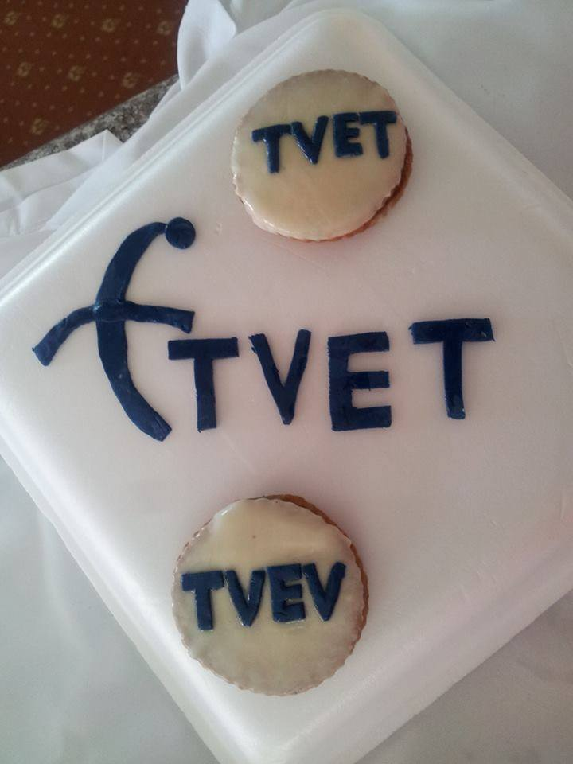
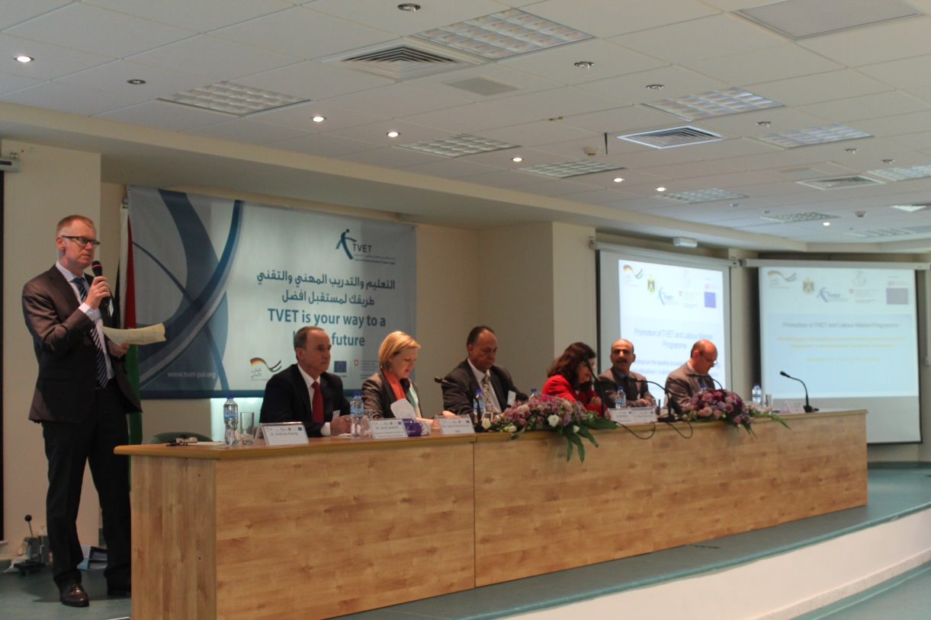
Visibility of TVET
Notes:
2014
LAB
Aesthetic/ethics of work
Resource cycle → enrich each other / generate
Description of job profiles
Exemplary loop to illustrate TVET education process/job profiles
Ambassadors/multipliers in each TVET institution (students deliver their message)
Commitment and ownership are created among partners and students
Measurements:
PR Material (Calendar 2015, brochures, image films, photos) in workshop under guidance of local consultant with students
Open Days before summer holidays (films, photos), education tours, panel discussions, live workshops, lectures → organized by students
Paragraph in each Newsletter designed and content by students of one TVET institution
Monthly radio show in local radio station organized by students who invite TVET guest speakers
Survey about TVET education, benefits, chances (→ collection of positive quotes about TVET)
Events: Labour Day, National Employment Week, Career Days, GIZ Events
“TVET style” (workshops, events, schools)
PR/PA Campaigns: Network of institutions in each governorate (Ramallah, Bethl., Hebron, Nablus) → create synergies

Slide 12
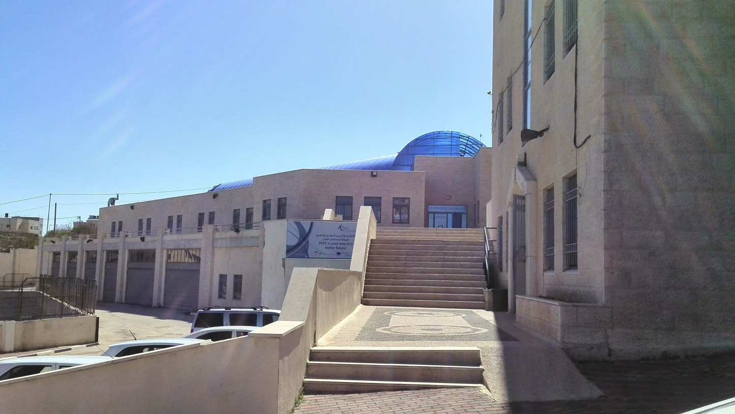
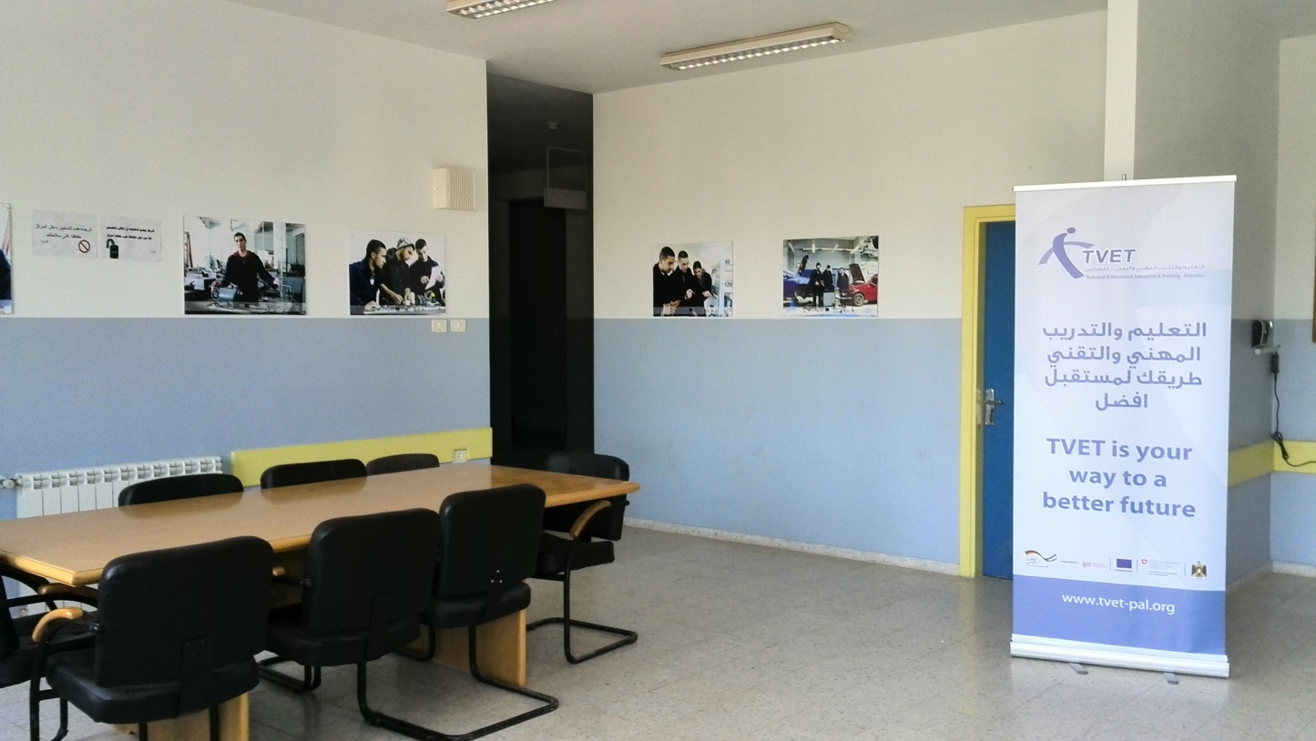
Visibility of TVET
Notes:
2014
LAB
Aesthetic/ethics of work
Resource cycle → enrich each other / generate
Description of job profiles
Exemplary loop to illustrate TVET education process/job profiles
Ambassadors/multipliers in each TVET institution (students deliver their message)
Commitment and ownership are created among partners and students
Measurements:
PR Material (Calendar 2015, brochures, image films, photos) in workshop under guidance of local consultant with students
Open Days before summer holidays (films, photos), education tours, panel discussions, live workshops, lectures → organized by students
Paragraph in each Newsletter designed and content by students of one TVET institution
Monthly radio show in local radio station organized by students who invite TVET guest speakers
Survey about TVET education, benefits, chances (→ collection of positive quotes about TVET)
Events: Labour Day, National Employment Week, Career Days, GIZ Events
“TVET style” (workshops, events, schools)
PR/PA Campaigns: Network of institutions in each governorate (Ramallah, Bethl., Hebron, Nablus) → create synergies

Slide 13
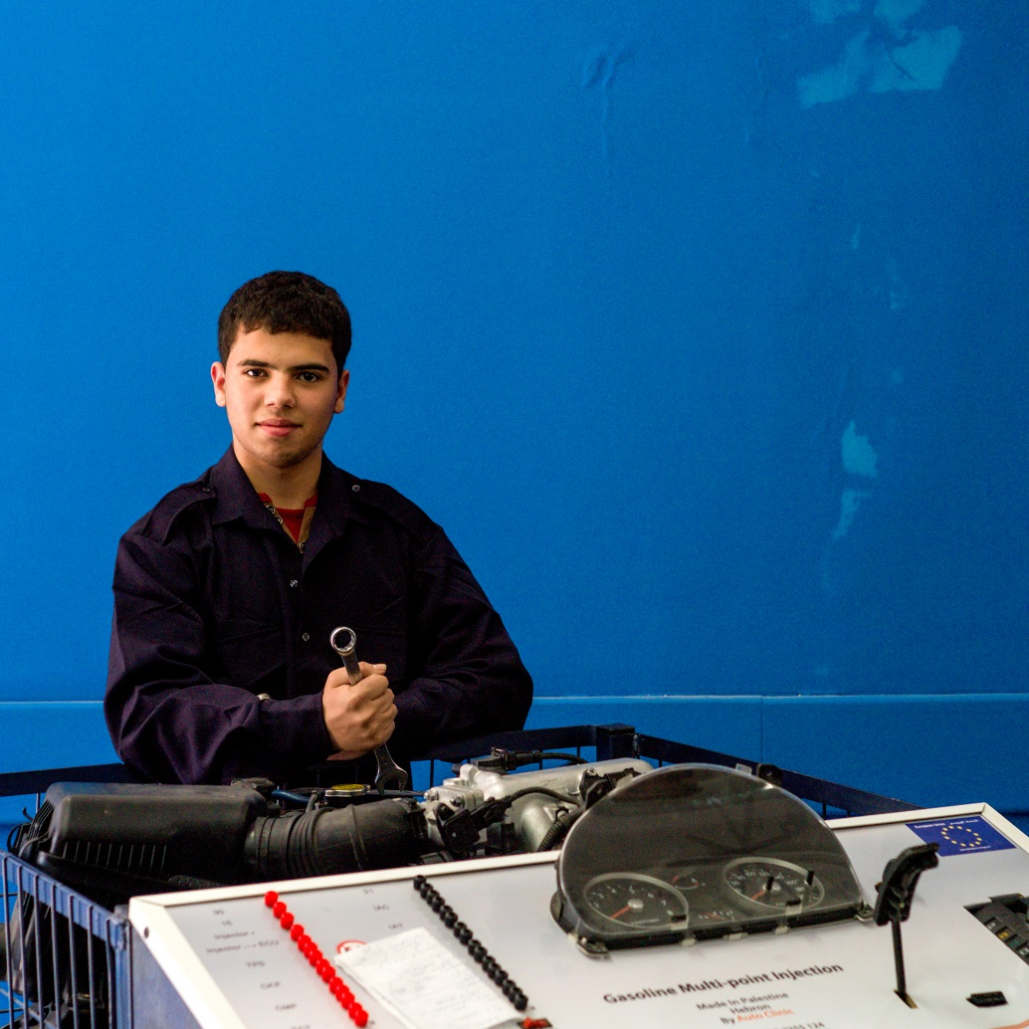
I chose the technical education of auto mechatronic because I like to work with my hands and the fact that at the end of the day there is a result produced by my own! Fadi, 16, ISS Nablus
Notes:
What message do we want to deliver to the different target groups?
A TVET education is a good choice for me/my child in terms of education/job opportunities/income perspectives. (Parents)
Education is the key to a satisfying career for many people, and is essential in giving Palestine a well-qualified workforce. (TVET Inst)
The services of TVET and LM provides my company with a skilled and educated work force and therefore ensures an economic prosperity to my business.
TVET and LM services/activities are vital to the competitiveness of the Palestinian economy and are a valid contribution to its economic welfare.
TVET is attractive and a full equivalent alternative to academic education and not a “second choice”!
It offers not only educational and career progress but also personal development.
It provides employment opportunities with regard to good income perspectives.
Education plays an important role in preparing the students for the right choice of employment, career and future life. The process of personal development, leading to the choice of the future career, begins very early in life.
The TVET system contributes in the building of our community, by creating jobs, reducing the unemployment rate and rotate the wheel of economy

Slide 14
“The TVET system contributes in the building of our community, by creating jobs, reducing the unemployment rate and rotate the wheel of economy.”
Mais Ibead, Teacher Ramallah Technical College

